Slide 1

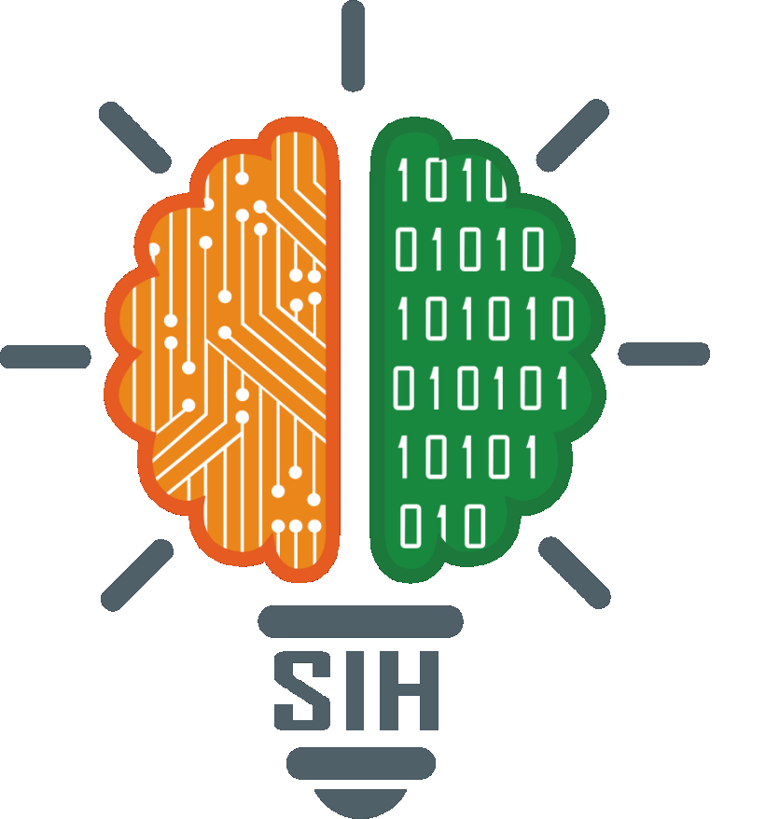
SMART INDIA HACKATHON 2026
TITLE PAGE
Problem Statement ID: SIH26037
Problem Statement Title: Adaptive Path Planning and Collision Avoidance for Autonomous Vehicles on Unstructured Indian Roads
Theme: Smart Vehicles
PS Category: Software
Team ID: TEAM-142
Team Name: HackHive

Slide 2
HackHive
THE IDEA
A Self-Driving Car Built for Indian Roads
01
Sense Everything on the Road
Camera, LiDAR and radar are fused together to spot cars, rickshaws, two-wheelers, pushcarts, pedestrians and even animals.
02
Predict What Happens Next
Every road user's likely next move is forecast, so the vehicle reacts before a conflict happens, not after.
03
Plan and Replan in Real Time
A safe path is generated and continuously updated - even where there are no lane markings, signals, or predictable merging.
04
Validated for Indian Conditions
Tested across 5 real Indian road scenarios and judged on replanning speed, path smoothness and safe-completion rate.
@SIH Idea submission - HackHive
2

Slide 3
HackHive
TECHNICAL APPROACH
Perceive → Predict → Plan → Replan
Built entirely in MATLAB and Simulink. RoadRunner generates village roads, unsignalled intersections and market-area scenes; Automated Driving Toolbox fuses camera, LiDAR and radar; Navigation Toolbox, Stateflow and Deep Learning Toolbox handle planning, decision logic and object detection.
Perceive
Predict
Plan
Decide
Actuate
Sensor fusion spots
road users
Forecasts each
agent's motion
Builds a
collision-free path
Stateflow rules for
merging & crossings
Vehicle dynamics
execute the path
Replan
Loop repeats in real time whenever a new obstacle or collision risk appears.
@SIH Idea submission - HackHive
3

Slide 4
HackHive
FEASIBILITY & VIABILITY
Grounded in a Proven Toolchain
WHAT WE BUILD ON
KEY CHALLENGE & HOW WE HANDLE IT
MathWorks toolchain end-to-end - MATLAB & Simulink
Indian Driving Dataset (IDD) for real-world road users
RoadRunner sample scenes for scenario generation
No custom hardware needed to validate in simulation
Unpredictable behaviour
Animals, jaywalking pedestrians and crowded market scenes.
Sensor noise build-up
Learned predictions backed by simple rule-based safety logic.
Real-time response
Replanning speed tuned before adding harder scenarios.
@SIH Idea submission - HackHive
4

Slide 5
HackHive
IMPACT & BENEFITS
Why This Matters
1
Benchmark for India
2
Fewer Accidents
Gives AV researchers, students and OEMs a benchmark platform for Indian mixed-traffic conditions - closing a gap left by planners built for structured, Western-style roads.
Safer outcomes in chaotic, mixed-traffic zones where conventional lane-based systems struggle.
3
De-risked Development
4
Smoother, Efficient Paths
Speeds up AV development for the Indian market before costly real-world trials.
Better-planned paths mean less unnecessary braking and lower fuel use.
@SIH Idea submission - HackHive
5

Slide 6
HackHive
RESEARCH & REFERENCES
Grounded in Real Data & Documentation
→
Indian Driving Dataset (IDD)
idd.insaan.iiit.ac.in
→
Mendeley Traffic Dataset
Indian road-condition traffic data
→
MathWorks Automated Driving Toolbox
Documentation & RoadRunner sample scenes
→
MathWorks Navigation Toolbox
Stateflow & Vehicle Dynamics Blockset docs
DETECT. PREDICT. PLAN. REPLAN. DRIVE SAFELY.
@SIH Idea submission - HackHive
6

